Slide 1
Machine learning identifies sources of heterogeneity in the human gut microbiota
06/24/2019
Jack Sklar
Ivan Vujkovic-Cvijin
Belkaid Laboratory, NIH/NIAID

Slide 2
Background:
Associations between microbiota composition and disease development/severity has been reported for most human inflammatory diseases
Traditional statistics combined with large numbers of comparisons (~100-1000 bacterial taxa per human gut) introduce high risk of false positives
False discovery rate corrections are inconsistently applied
Small sample sizes hamper capacity to make conclusions due to tremendous heterogeneity in human gut microbiota profiles
Capacity to discern true microbiota differences can be improved by:
Identifying and controlling for sources of heterogeneity in the human gut microbiota
Development and adoption of analytical techniques to overcome false discovery
Notes:
Studies commonly report associations between microbiota and most human inflammatory diseases
High diversity of OTUs leave high likelihood for false discovery using trad stats,
Lack of consensus on correcting for FD of associations
Possible that these are real, likelihood is low, and many of them have conflicting results
Difficulties in coming up with standards
Only share 10-20% of taxa between individuals
Improvements in controlling for sources of heterogeneity coupled with robust, conservative methods for inferring associations can overcome these issues

Slide 3
American Gut Project:
“Citizen-science” approach: crowdsourcing microbiota sampling by allowing any (paying) individual to participate in sample collection and submission
Overseen by lab of Rob Knight using standardized sample processing protocols
Extensive questionnaire administered included questions pertaining to: diet, age, sex, BMI, exercise, alcohol intake, inflammatory disease status, bowel movement characteristics, antibiotic history, etc.
Question: do any of these variables explain heterogeneity in gut microbiomes?
> 10,000 gut samples, allowing for predictive analysis
Notes:
In recent years, citizen science projects have emerged to help produce huge datasets, where otherwise far too expensive for single studies
Allows for the discovery of broad associations
With over 10,000 human gut metagenome samples, it is perfect for using machine learning to assess robust lifestyle factors associated with microbiome patterns
wanted to know from these questionnaire variables, are there any that may explain microbiota compositional patterns

Slide 4
Machine learning for quantifying effects of host variables on microbiota profiles:
Train classifier using bacterial taxon abundances to optimally discriminate between cases vs. controls
Performance on validation data is a proxy for the performance on unseen data (i.e. generalizability), which reduces chances false discovery
Yield a numerical value (AUROC) for the discriminatory power of classifier to distinguish cases from controls based on the microbiota
Extract OTU feature importance from model, which define importance of OTU toward classification of response variable
Cons:
Requires larger datasets than are typical for standard human microbiome studies
Potential for finding signal in noise remains (false positive)
Notes:
Model defines hypothesis of microbiota based thresholds that discriminate between groups
Evaluation of the model on validation set is an instance of hypothesis testing
Given finite dataset, cross validation is performed to obtain a error-stabilized estimation of generalized classification ability

Slide 5

Random forests analysis
Single decision tree (Simplified):
Random forest:
independently train fully-grown decision on a random subset of training data
Predictions from all N trees are aggregated into one prediction
Aggregation prevents overfitting
Random subset of cases and controls (‘training set’)
Gut microbiota profiles of cases and controls
Taxon that best discriminates cases from controls
Subjects with low abundance
Subjects with high abundance
Taxon that best discriminates cases from controls in this group of samples
Taxon that best discriminates cases from controls in this group of samples
low
high
low
high
Notes:
Each decision tree is trained independently on a bootstrapped sample of the training dataset
Trees are grown until splits no longer produce an increase in information
Improves algorithm stability, accuracy, reduces variance
the probability that the classifier ranks a randomly chosen positive sample higher than a randomly chosen negative one

Slide 6
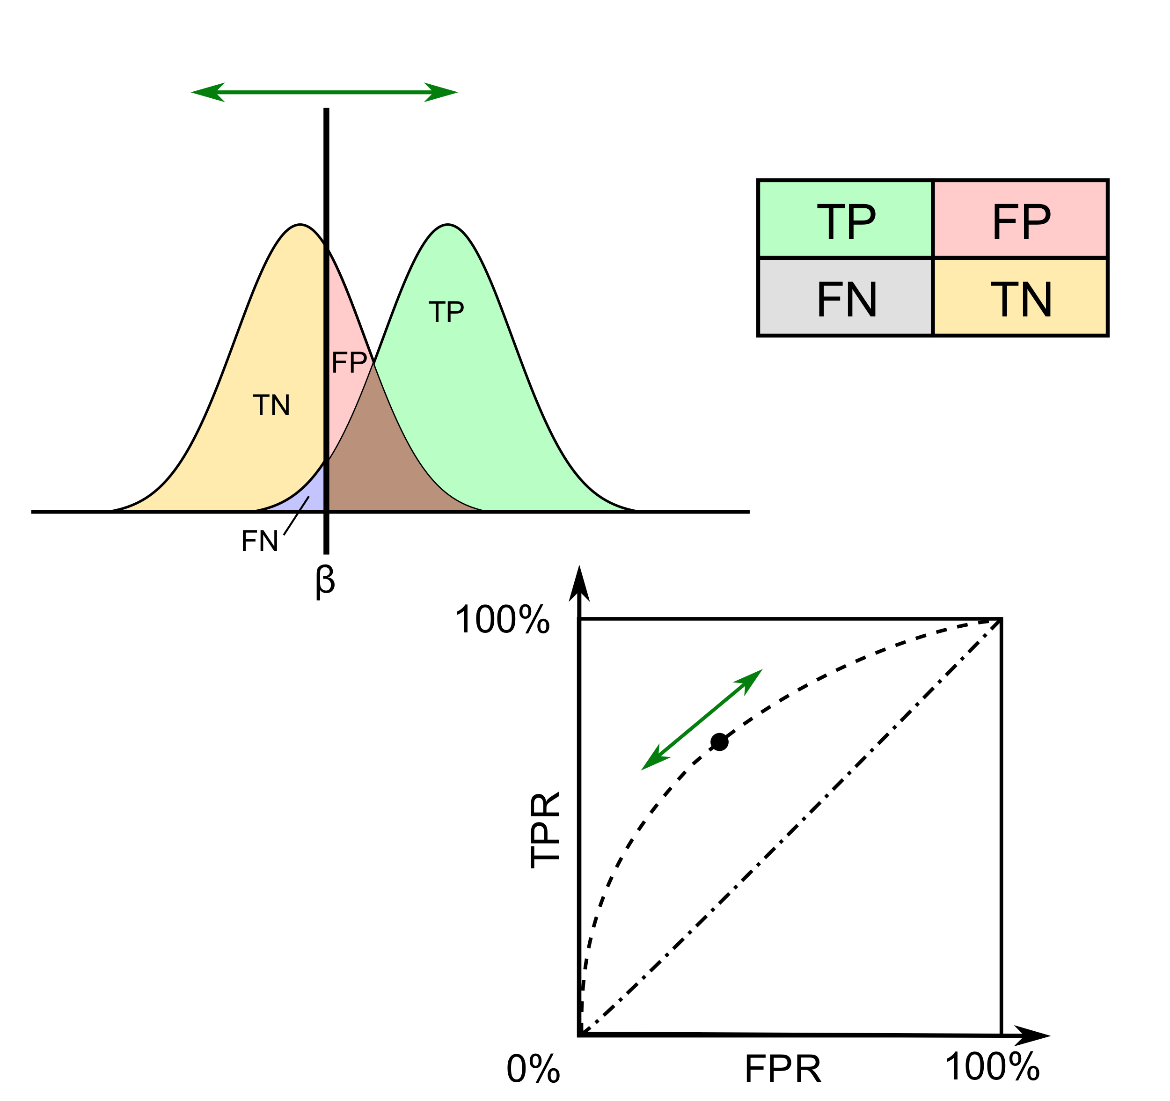
Binary classifier prediction metrics
Receiver-operator characteristic curve (ROC): true positive rate vs. false positive rate across range of decision threshold values
Area under the Curve:
Interpretation: the probability that given a random case and control that the classifier will predict (the positive class probability) the case higher than the control
Ranges from 0.5 (random chance) to 1.0 (perfect Classification)

Slide 7
American Gut Project (AGP) data processing:
16s raw data re-processed using dada2 algorithm
After rarefaction, removal of duplicates and missing metadata: 8,738 samples
Healthy control population: ﻿5,541 subjects
Ages: [19-80]
BMI: [12.5-30.0]
No participants with IBD or diabetes
No antibiotic use within the last 6 months
Simulate paired-sample cohort for each questionnaire variable
Control group selected from ‘healthy population’ to match each ‘case’ for: age, BMI, longitude, latitude, race, sex

Slide 9
Classification of samples using microbiota profiles:
Machine learning classifier used:
Random forest
Predictive analysis:
Case+control cohort is split, with 70% going toward training set for random forest model building, 30% toward testing accuracy of model
Assessment of noise and type I error: Samples from same cohort are randomly assigned case/control status, and identical procedure performed again
The mean-AUC is computed as the quantification of the strength of microbiome association to host variable
Process applied to all questionnaire variables, threshold P-value < 0.05
Notes:
Also tried extreme gradient boosted trees (XGB), lasso-logistic Regression
taken as significantly picking up microbiome associated signature to host variable

Slide 10
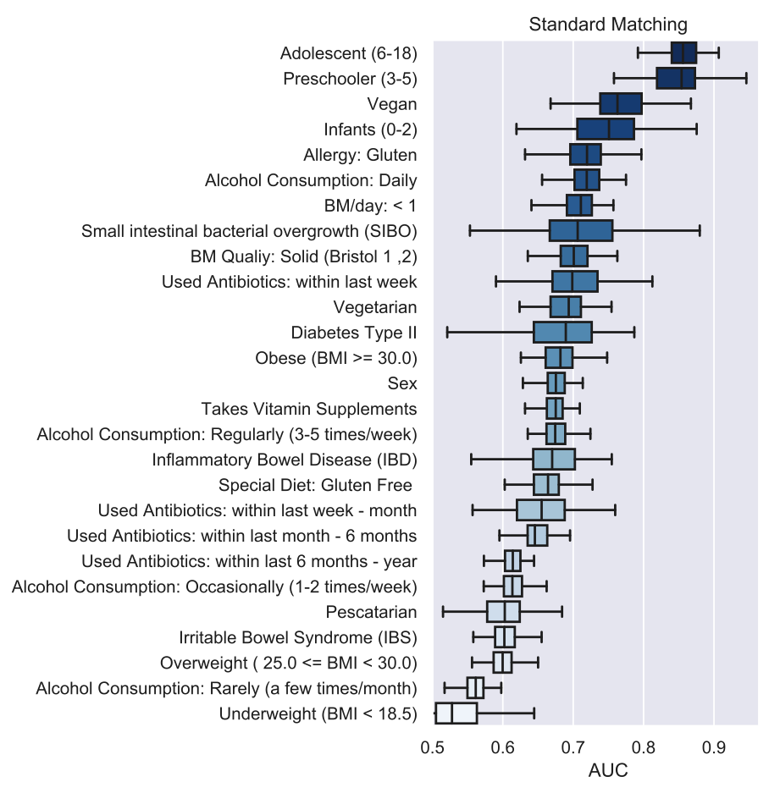
Host variable AUC results:
CV Random Forest Model Results
★
★
★
★
★
★
★
★ = standard, common criteria for removing subjects from study cohorts
★ = standard, common criteria for matching among cases and controls
★ = suggested criteria for matching among cases and controls
★
★
★
★
★
★
★
★
★
★
★
Notes:
Results for most discriminatory lifestyle variables as well as performance of standard matching criteria variables

Slide 11
Frequency variable results: alcohol consumption
Daily
Regularly (3-5 times/week)
Occasionally (1-2 times/week)
Rarely (< 1 times/week)
Never (Control Group)
Notes:
XTION: we think that uncovering these kinds of common environmental variables having an effect on the microbiome is important, will show you why

Slide 12
Frequency variable results: alcohol consumption

Slide 13
Frequency variable results: alcohol consumption

Slide 14
Alcohol results: validation from external Cohort
Dutch-HIV cohort, gut microbiome samples with alcohol consumption metadata:
Cohort of [daily-weekly] vs. [monthly vs. never] drinkers
AGP daily alcohol consumption (never-drinker control group)
Log mean fold change of common genera between Dutch and AGP drinking cohorts
Positive correlation of mfc at genus level between cohorts

Slide 15
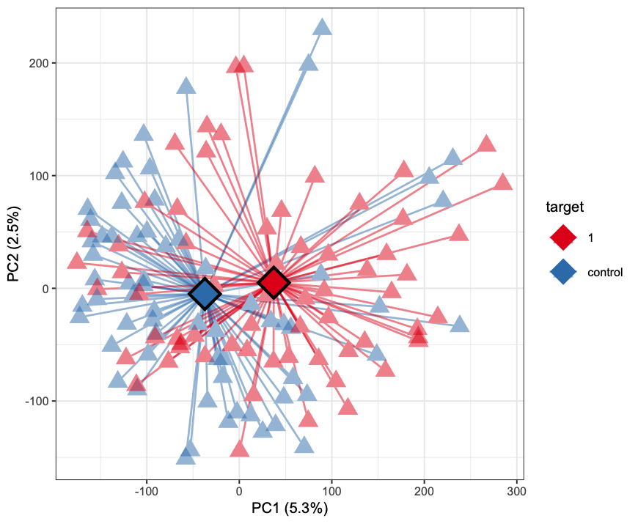
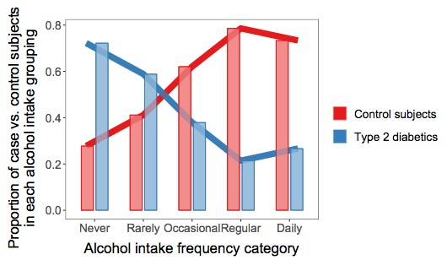
Type 2 diabetes exhibits a strong gut microbiota signature
Alcohol intake differs drastically between cases and controls
Centroids
case
control
P<1*10⁻⁴
Notes:
Representation of alcohol consumption groups are not balanced between cases and controls
Diabetics are more likely to drink less often, where cases, based on standard matching criteria drink more frequently

Slide 16
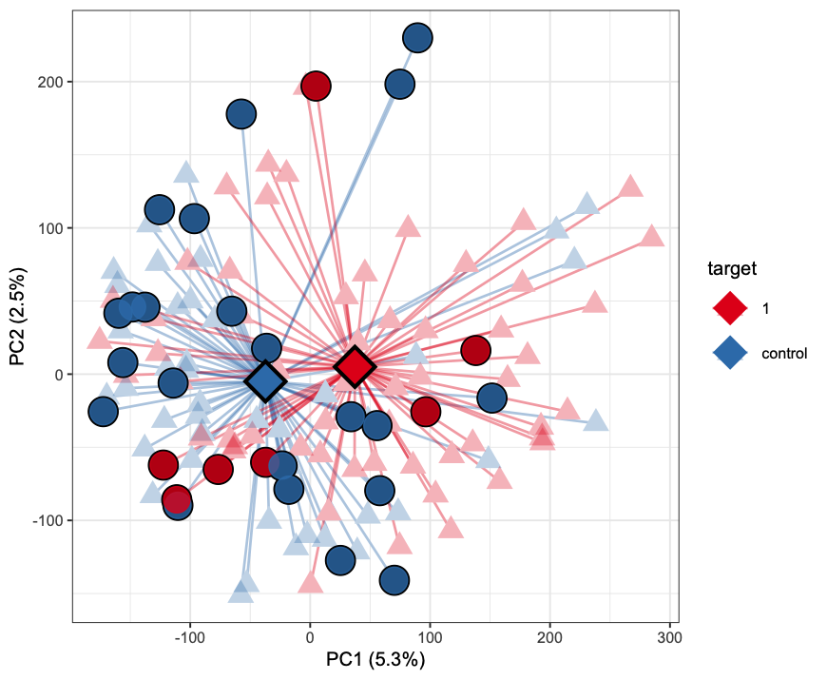

Type 2 diabetes exhibits a strong gut microbiota signature
Re-selected a healthy control comparator population that is matched for alcohol intake
Daily alcohol
consumer, T2D
Daily alcohol
consumer, control
Centroids
case
control
P<1*10⁻⁴

Slide 17
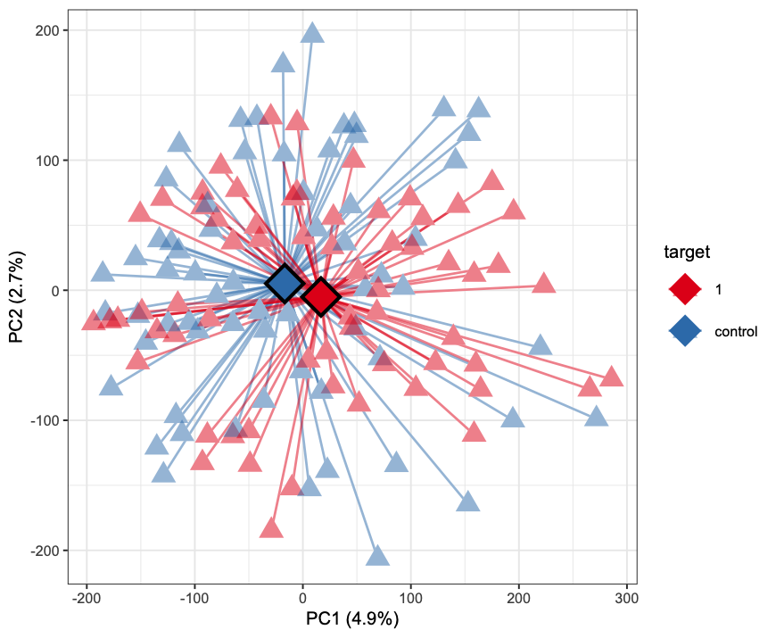
Type 2 diabetes exhibits a strong gut microbiota signature when cohort is not matched for alcohol intake
Cases + controls matched for alcohol intake
Daily alcohol
consumer, T2D
Daily alcohol
consumer, control
Centroids
Centroids
case
control
case
control
P<1*10⁻⁴
P = 0.017

Slide 18
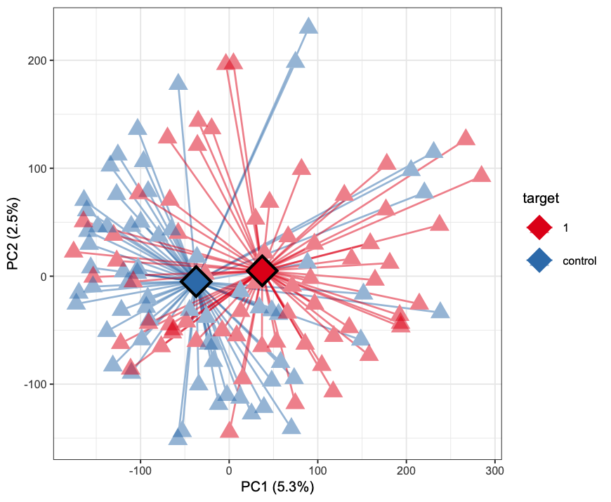
Type 2 diabetes exhibits a strong gut microbiota signature when cohort is not matched for alcohol intake
Cases + controls matched for alcohol intake
Daily alcohol
consumer, T2D
Daily alcohol
consumer, control
Centroids
Centroids
case
control
case
control
P<1*10⁻⁴
P = 0.017

Slide 19
Improved human subject cohort guidelines
Top performing host-variable AUC distributions
Highest AUC-change after
updated-matching
Notes:
Updated matching had greatest effect on smallest cohorts (i.e. rarest diseases) where confounding factors had greatest chance of influencing model performance

Slide 20
Additional frequency variables worth considering

Slide 21
5-year age-group classification:
Classification of healthy participants across full age range, binned into 16 5-year age-groups using linear SVM classifier
Normalized confusion matrix of predictions from 5-repeat 10-fold cross-validation
Decreasing predictive capacity to as age groups move into adulthood
Adolescent cohort has clearest microbiota signature
Normalized confusion of age-group prediction

Slide 22
Additional Work:
Permute cross-validation training/test split by paired samples
If case A gets put into test set, control A should be put into it as well
Full dataset is matched between cases and controls but a random permutation split for training and test sets have no gaurentee

Slide 23
Conclusions and remaining questions
Future comparative human gut microbiota studies should expand matching criteria for cases and controls beyond just BMI, age, sex, and antibiotic intake:
Alcohol intake
Veganism and vegetarianism
BM <1/day
Red meat frequency
Poultry frequency (>3 times per week)
Milk/cheese frequency (>5 times per week)
Type II diabetes microbiota studies that did not actively match subjects and controls for alcohol frequency should be re-examined
Question: Why do type II diabetics tend to drink less alcohol?
Meta-analysis revealed alcohol drinkers are 30% less likely to develop T2D (Koppes et al. Diab. Care 2015)
Alternatively, T2D diagnosis/symptomatology may affect alcohol intake choice
Differences in alcohol intake frequency should be examined for all diseases linked to microbiota in order to evaluate whether microbiota studies should be redesigned and repeated

Slide 24

Acknowledgements
Ivan Vujkovic-Cvijin
Yasmine Belkaid (NIAID/NIH)

